Slide 1


Explain price elasticity of demand and its significance in the market.
NAME – SWEETY KUMARI
SECTION – “B”
STUDENT CODE – BBA/BWU/23/104
COURSE CODE – BBA20001
COURSE NAME – PRINCIPLES OF MICROECONOMICS

Slide 2
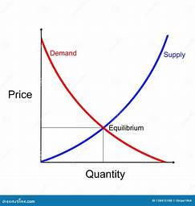
Introduction to Price Elasticity of Demand
Price elasticity of demand is a fundamental economic concept that measures the responsiveness of consumer demand to changes in the price of a product or service. Understanding this concept is crucial for businesses to make informed pricing decisions and optimize revenue.

Slide 3


Definition of Price Elasticity of Demand
Price elasticity of demand measures the sensitivity of consumer demand to changes in the price of a product. It quantifies the percentage change in quantity demanded relative to the percentage change in price. This concept is crucial for businesses to understand and optimize pricing strategies.

Slide 4
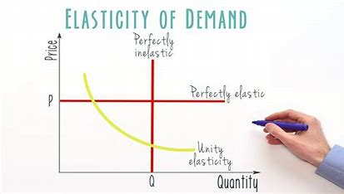

Factors Affecting Price Elasticity of Demand
Product Necessity: Goods and services considered essential have lower price elasticity, as consumers are less responsive to price changes.
Availability of Substitutes: Products with many available substitutes tend to have higher price elasticity, as consumers can easily switch to alternatives.
Time Period: Demand is generally more elastic in the long run, as consumers have more time to adjust their purchasing habits in response to price changes.

Slide 5
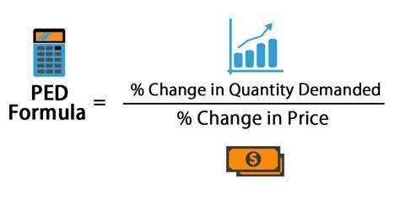
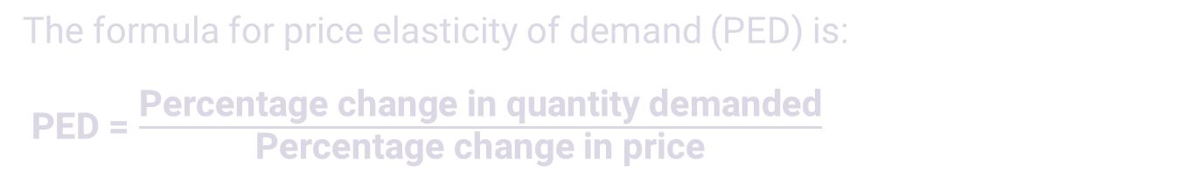
Formula for Price Elasticity of Demand
The formula for price elasticity of demand (PED) is:
PED = $\frac{\text{Percentage} \text{change} \text{in} \text{quantity} \text{demanded}}{\text{Percentage} \text{change} \text{in} \text{price}}$
This formula allows businesses to quantify the responsiveness of consumers to price changes. By calculating PED, companies can make informed decisions about pricing strategies to optimize revenue and profitability.

Slide 6
Calculation of Price Elasticity of Demand
Calculating price elasticity of demand involves a simple formula that compares the percentage change in quantity demanded to the percentage change in price. By determining this ratio, businesses can understand how responsive consumers are to price fluctuations and make informed pricing decisions.
1.2
0.8
Price Elasticity
Price Inelastic
A value of 1.2 indicates that a 1% increase in price would lead to a 1.2% decrease in quantity demanded.
A value below 1 signifies that demand is price inelastic, where consumers are less responsive to price changes.

Slide 7
Types of Price Elasticity of Demand
1
Elastic Demand
2
Inelastic Demand
When the price elasticity of demand is greater than 1, it indicates elastic demand. In this case, a small change in price leads to a larger change in quantity demanded. Consumers are highly responsive to price changes.
When the price elasticity of demand is less than 1, it indicates inelastic demand. Here, the quantity demanded changes by a smaller percentage than the change in price. Consumers are less responsive to price fluctuations.
3
Unitary Elastic Demand
4
Perfectly Elastic and Inelastic
When the price elasticity of demand is exactly 1, it is known as unitary elastic demand. In this scenario, the percentage change in quantity demanded is equal to the percentage change in price.
Perfectly elastic demand has a PED value of infinity, where even the slightest price change leads to a complete shift in demand. Perfectly inelastic demand has a PED of 0, meaning quantity demanded does not change with price.

Slide 8
Significance of Price Elasticity of Demand
1
Pricing Strategies
2
Revenue Forecasting
Understanding price elasticity helps businesses set optimal prices to maximize revenue and profits.
Knowing the price elasticity of demand allows companies to accurately predict how changes in price will impact sales volumes and overall revenue.
3
Inventory Management
4
Government Policy Decisions
Firms can better manage inventory levels and production planning based on the price sensitivity of consumers.
Policymakers use price elasticity data to assess the impact of taxes, subsidies, and regulations on consumer behavior.

Slide 9
Impact of Price Elasticity on Revenue
The price elasticity of demand directly impacts a company's revenue. Firms with elastic demand can increase revenue by lowering prices, as the resulting rise in quantity demanded offsets the lower price. Conversely, companies with inelastic demand can maximize revenue by raising prices.

Slide 10
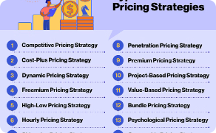

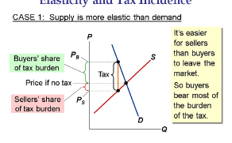
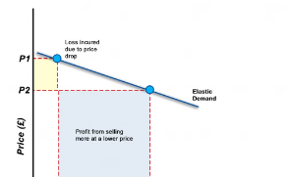
Practical Applications of Price Elasticity of Demand
Pricing Optimization
Inventory Planning
Policy Decisions
Market Segmentation
Policymakers rely on price elasticity analysis to assess the impact of taxes, subsidies, and regulations on consumer behavior and overall market outcomes.
Businesses use price elasticity data to set optimal prices that maximize revenue and profits based on consumer sensitivity to price changes.
Knowledge of price elasticity helps companies forecast demand and plan production to avoid stockouts or excessive inventory for products with varying price sensitivity.
Businesses can identify and target customer segments with varying price sensitivities, allowing them to implement differential pricing strategies for maximum profitability.

Slide 11
Conclusion and Key Takeaways
Vital Business Metric: Price elasticity of demand is a critical concept that enables companies to set optimal prices, forecast revenue, and manage inventory effectively.
Responsive Pricing Strategies: Understanding how price changes impact consumer demand allows firms to dynamically adjust prices to maximize profitability.
Holistic Market Analysis: Analyzing price elasticity provides valuable insights into consumer behavior, product substitution, and the overall competitive landscape.
Informed Policy Decisions: Policymakers rely on price elasticity data to assess the impact of economic policies and regulations on consumer welfare.
Continuous Improvement: Regularly monitoring and updating price elasticity measurements enables businesses to stay agile and responsive to evolving market conditions. 🚀

Slide 12
THANK YOU

